Slide 1
Overview of Next-generation Short Read Sequencing Technologies, Emerging platforms, and Experimental Design
Elaine R. Mardis, Ph.D., FAACR
Co-Executive Director, The Steve and Cindy Rasmussen Institute for Genomic Medicine at Nationwide Children’s Hospital
The Steve and Cindy Rasmussen Nationwide Foundation Endowed Chair in Genomic Medicine
Professor of Pediatrics and Neurosurgery, The Ohio State University College of Medicine

Slide 2
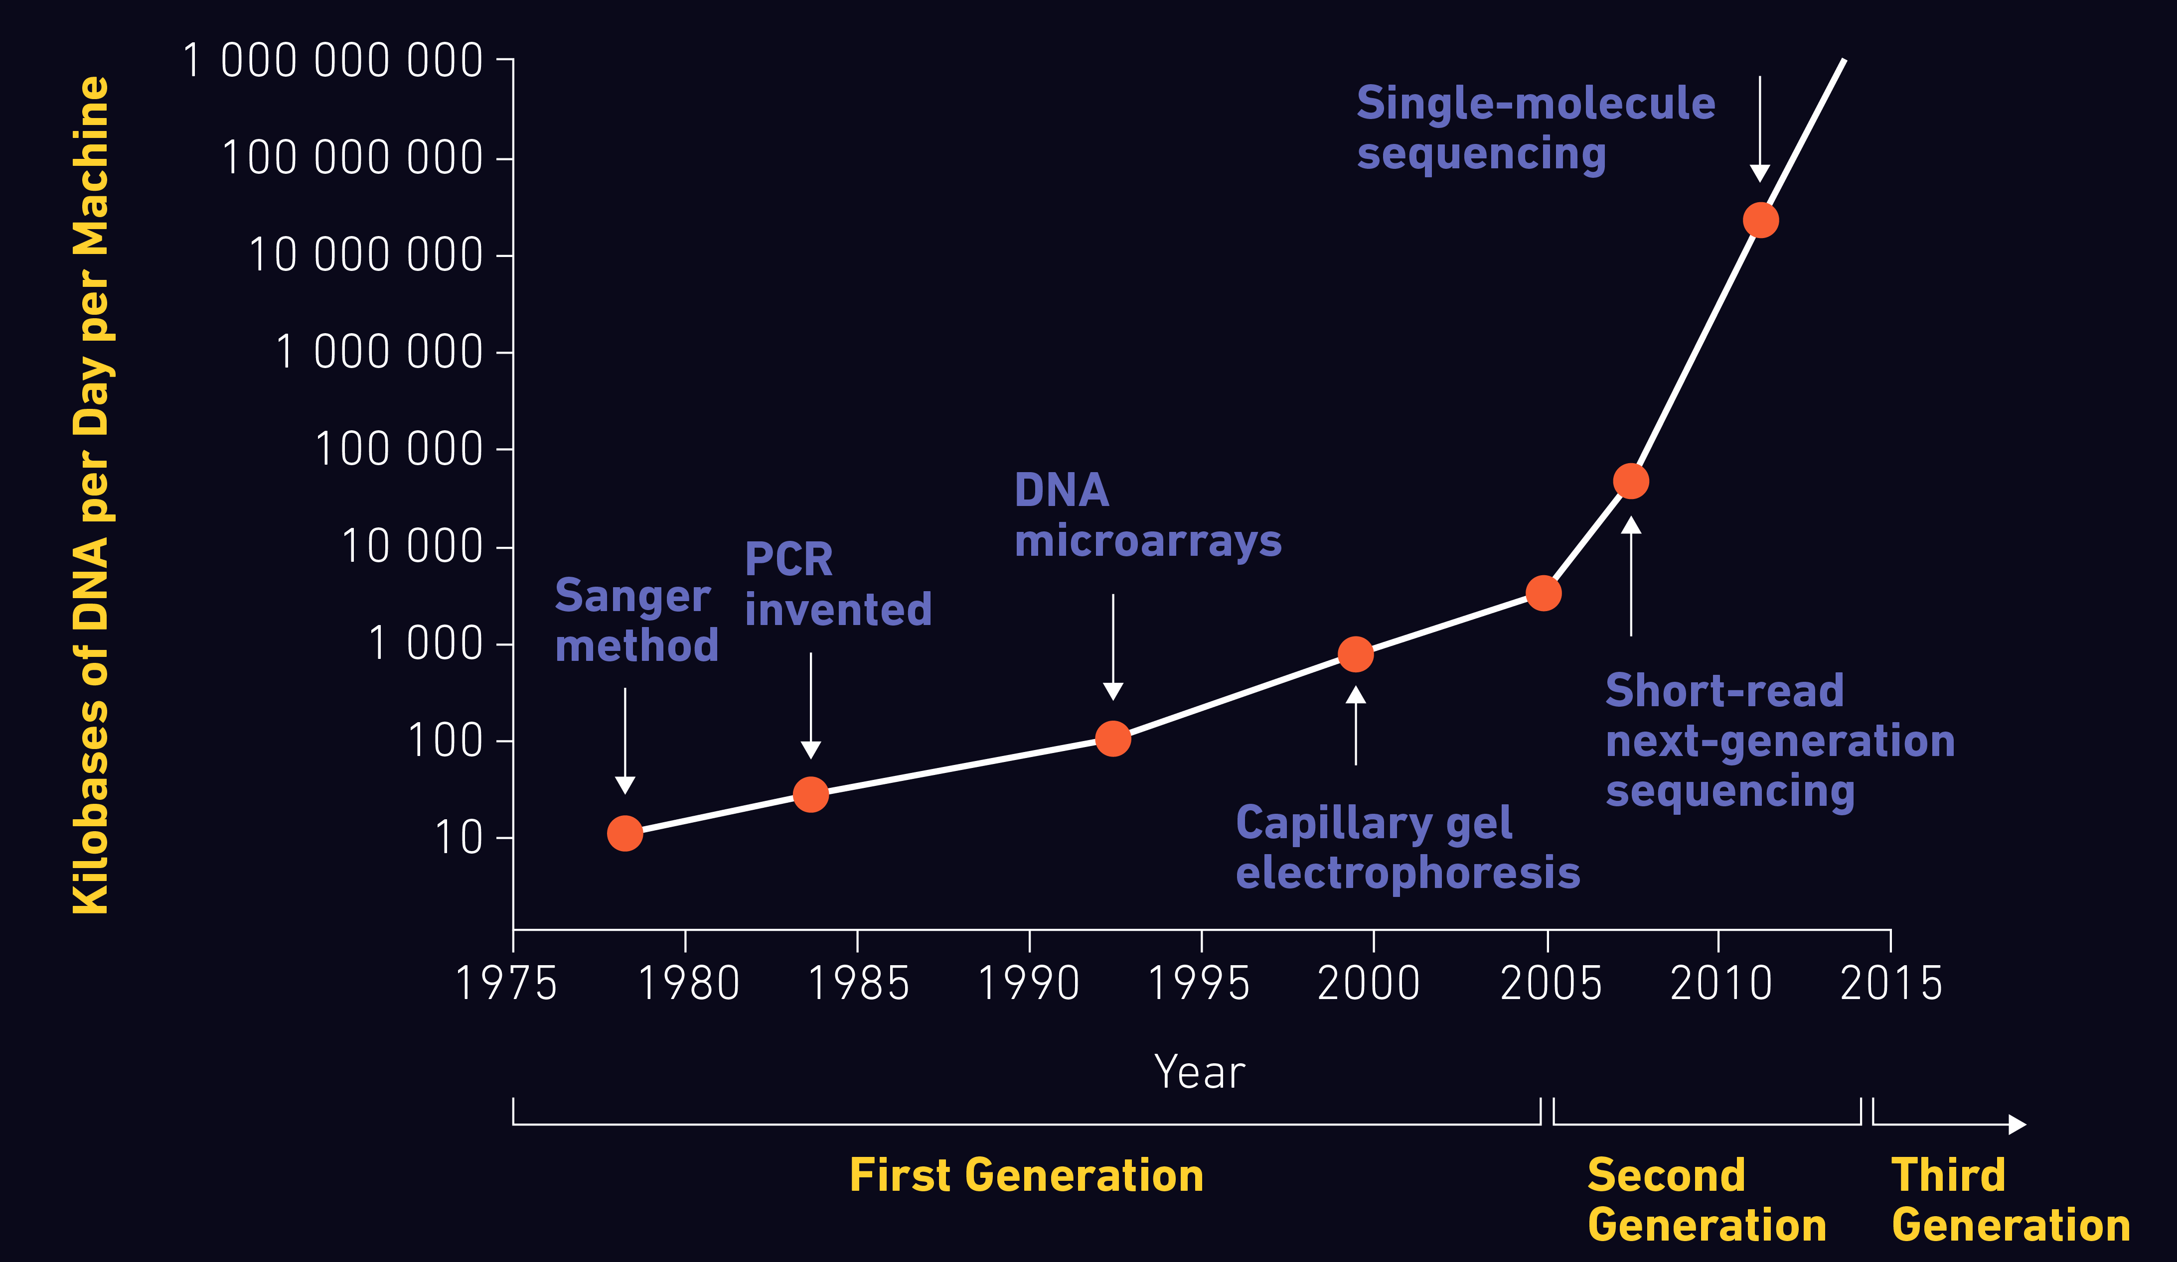
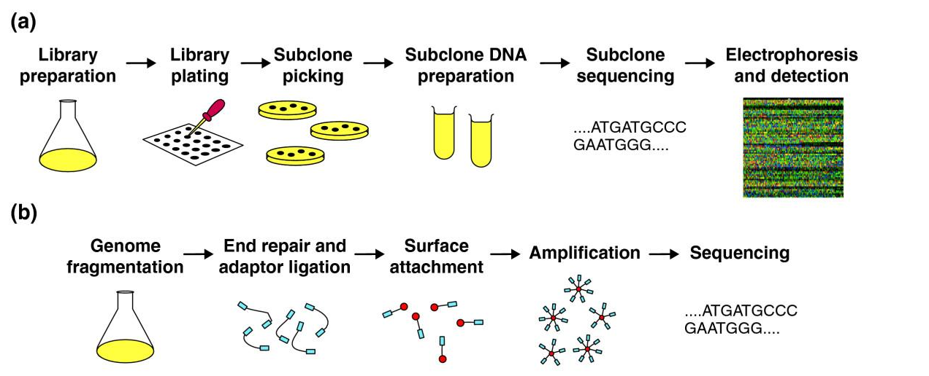
NGS has transformed biomedical inquiry

Slide 3
The Applications are Endless...

Slide 4
General Considerations in NGS Experimental Design
Sample preservation:
the preservation method can affect nucleic acid integrity
quality and quantity of nucleic acid(s) can shape subsequent decisions
What nucleic acid type(s) will be studied:
preservation method and extraction method determine the approach used
need for DNA and/or RNA will also factor into decisions about approach
the physical size of the sample and extraction method can determine the yield of nucleic acid(s) obtained, and may dictate the NGS library approach
General considerations:
Performing QC at each “transition step” in the preparatory processing is important
Including informative controls is important
Performing duplicate experiments (when possible) is important
Conducting orthogonal validation of results is (still) important!

Slide 5
Next Generation Sequencing Basics
How massively parallel sequencing works

Slide 6
Next Generation Sequencing: the basics
NGS library construction combines DNA or RNA fragments with custom synthetic DNA adapters by ligation or transposon insertion
The resulting library fragments are amplified on a solid support (either a bead, flat surface or nanowell-covered surface) with covalently attached adapters complimentary to the library adapters
Sequencing reactions couple nucleotide incorporation and detection in a step-wise fashion, detecting hundreds of millions to billions of sequencing reactions per instrument run = “massively parallel sequencing”
NGS short read lengths require an initial step of genome (or other reference) alignment prior to specialized bioinformatics-based analyses

Slide 7
Input DNA for NGS Libraries
Generally speaking, NGS sequencing libraries are ‘short insert’, with fragment sizes ranging from ~200-600 bp
Starting material for NGS libraries may be derived from numerous different sources, including:
- high molecular weight genomic DNA (cell lines, blood, fresh or frozen tissue, buccal swab/cheek scrape)
- PCR products, including from multiplex PCR
- low molecular weight/degraded DNA (formalin-fixed paraffin-embedded (FFPE) tissues, forensic specimens, Neanderthal bones)
- RNA from any source, typically converted into DNA via reverse transcriptase
So, the first consideration is the method of DNA/RNA isolation that fits sample type/preservation
Evaluating the quality/intactness and yield of DNA/RNA obtained is a critical next step

Slide 8
Evaluating Input DNA Quality and Quantity
DNA Quality/Intactness:
- cheapest = agarose gel and ethidium staining
- easiest = precast gel (Flash)
- large sample numbers: Agilent BioAnalyzer or TapeStation
DNA Quantity:
- NanoDrop (with caveats)
- Qubit
- PicoGreen + 96 well plate reader
If high mw and concentration, fragmentation is next
If low mw and concentration, challenges and adjustments will be required!

Slide 9
Fragmenting High MW Genomic DNA
Mechanical methods:
- syringe/needle high pressure shearing device
- HydroShear device
- Covaris ultrasonicator or G-tube device
Enzymatic methods:
- restriction enzyme(s) cleavage
- Zinc treatment
- proprietary nuclease cocktail / “fragmentase”
Initially, examine post-shearing of a control or abundant sample to optimize size range and yield within

Slide 10
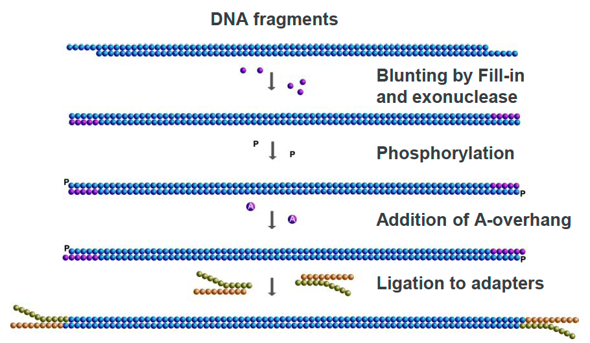
Adapter Ligation-based Library Construction
Shear or enzymatically treat high molecular weight DNA to fragment, OR derive DNA fragments from other preparatory methods
Enzymatic treatments to blunt ends
Ligate synthetic DNA adapters (with indexes), PCR amplify
Quantitate and size library (quality control)
Proceed to WGS, or isolate exome or specific panel by hybrid capture

Slide 11
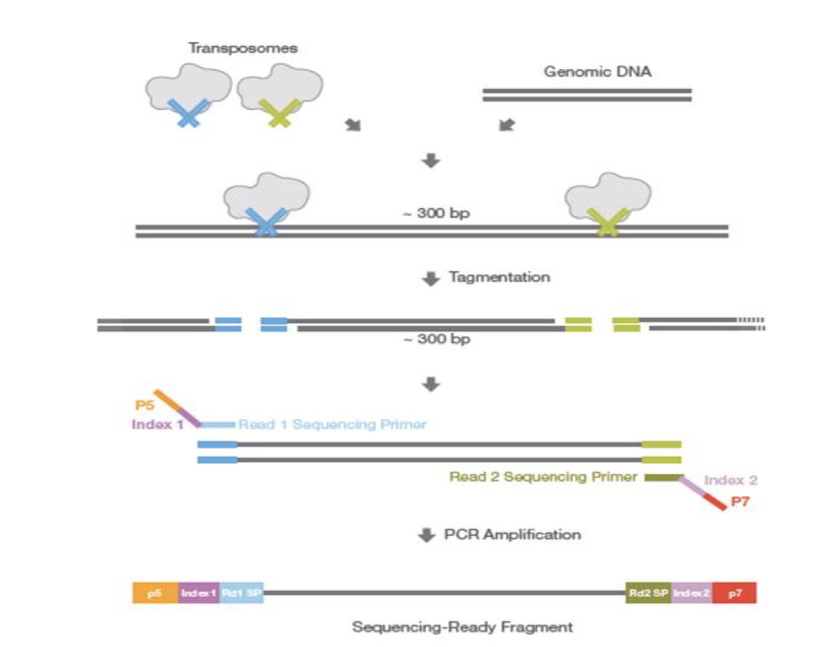
Transposon-based Library Construction
The use of engineered transposons to insert library adapter sequences into high mw DNA
Ideally suited for low amounts of high mw DNA
Forms the basis for ATAC-seq approach because transposons only insert into open chromatin
Initial titration of Tn:DNA may be needed to optimize NGS library fragment size range
Subsequent ligation of barcodes/index sequences following Tn insertion is possible

Slide 12
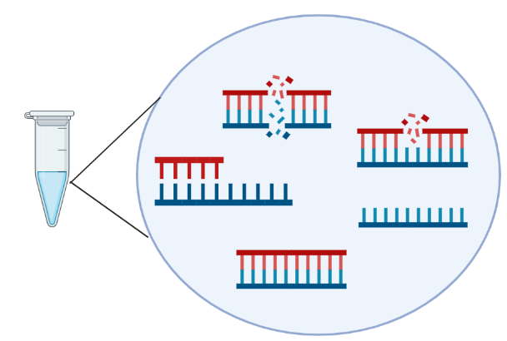
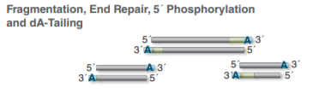
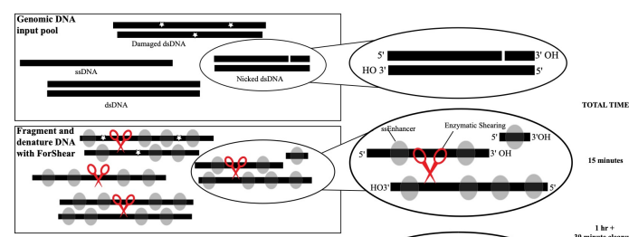
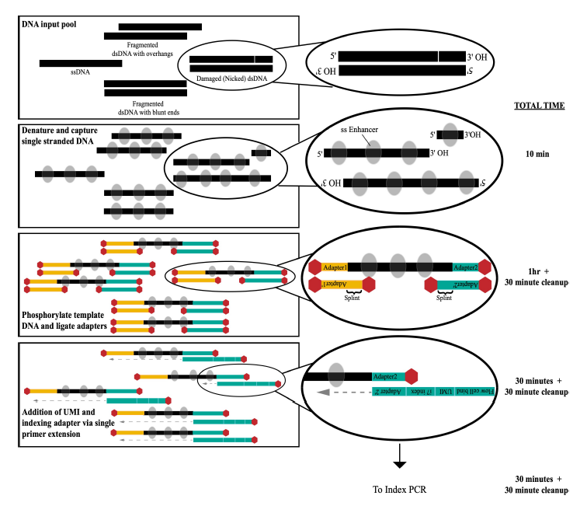
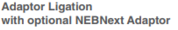
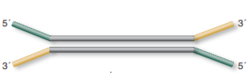
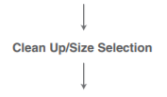
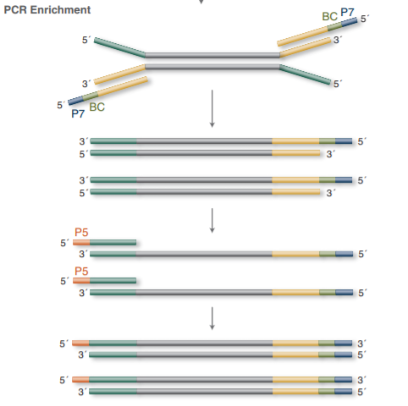
Library Prep Workflow Comparison for differential input DNA
NEBNext Ultra II FS
Claret SRSLY
with IDT unique-dual-indexed adapter
i5 index incorporation

Slide 13
PCR-related Problems in NGS
PCR is an effective vehicle for amplifying DNA, however…
In NGS library construction, PCR can introduce preferential amplification (“jackpotting”) of certain fragments
Duplicate reads with exact start/stop alignments
Need to “de-duplicate” after alignment and keep only one pair
Low input DNA amounts favor jackpotting due to lack of complexity in the fragment population
PCR also introduces false positive artifacts due to substitution errors by the polymerase
If substitution occurs in early PCR cycles, error appears as a true variant
If substitution occurs in later cycles, error typically is drowned out by correctly copied fragments in the cluster
Cluster formation is a type of PCR (“bridge amplification”)
Introduces bias in amplifying high and low G+C fragments
Reduced coverage at these loci is a result

Slide 14
RNAseq

Slide 15
RNAseq: Why and How
Increasing emphasis on sequencing the transcriptome, followed by data analysis with multiple pipelines depending on the experimental question(s)
Fusion detection, exon skipping, allele-specific silencing/expression, epigenetic links to driver gene expression, cluster-based analysis, immune deconvolution (in cancer)
Multiple RNA types are being identified and linked causally to disease and other mechanisms of gene regulation (miRNAs, lncRNAs)
Analysis outputs may characterize differential gene expression, alternative splicing, RNA editing, pathway activation/deactivation, integration with chromatin conformation changes, and so on (R-based data display)
Provides a gene set for organisms without a reference genome

Slide 16
RNAseq Challenges
RNA is sensitive to degradation from heat and FFPE treatment (QC is critical)
Genomic DNA co-isolates with RNA and requires DNAse treatment prior to library preparation
Super abundance of ribosomal RNAs requires a method to diminish this population (various methods) prior to library preparation
Alternatively, one can isolate mRNA by polyA+ selection methods, but this approach decreases the total amount of RNA and biases fragments toward 3’ end of gene
Strandedness may be important for desired analyses and can determine library preparation method
Short reads may challenge detection of certain RNA-specific attributes or aberrations difficult (exon skipping via alternative splicing, etc.)
Since all genes are expressed at different levels, “coverage” is not a metric for RNAseq

Slide 17
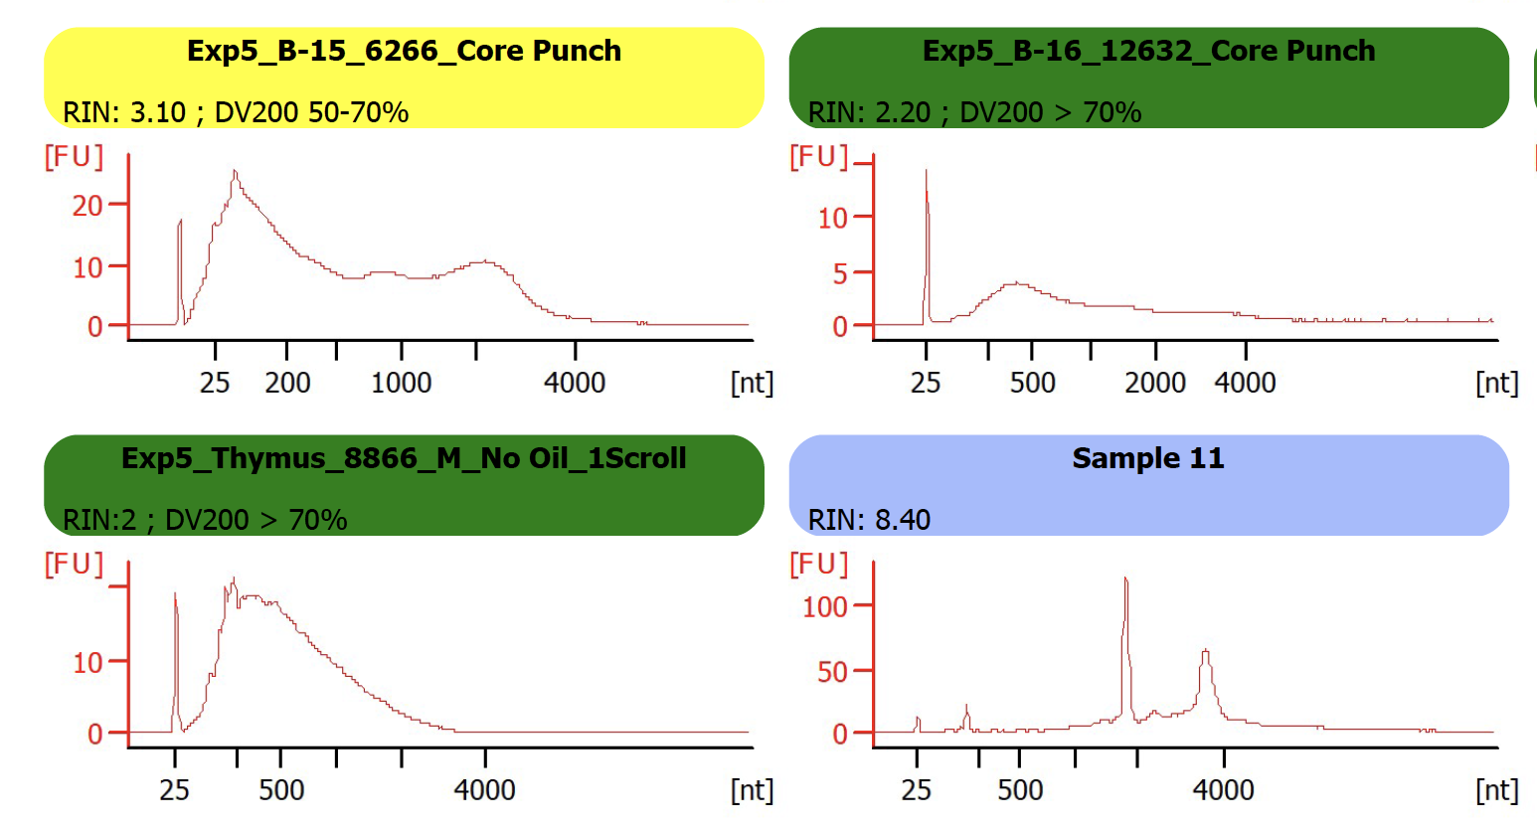
QC of RNA is Essential
These RNA data from Agilent TapeStation illustrate the different size distributions of RNA samples
RIN (RNA Integrity Numbers) and DV200 (percentage of fragments below 200 bp) values are QC metrics

Slide 18
NEBNext Ultra II Directional
Total RNA
(100 ng – 1 µg)
Anneal to DNA probes
Digest DNA/RNA hybrid with RNase H
Digest DNA probes with DNase
rRNA depletion
SPRIselect purification
RNA fragmentation
First-strand cDNA synthesis
Second-strand cDNA synthesis
SPRIselect purification
End Prep
Repair DNA ends
3’ adenylation
Adapter ligation
(IDT xGen Dual Index UMI Adapters)
SPRIselect purification
qPCR cycle
optimization
Hybrid Capture
IDT xGen Lockdown Probes
Enrichment PCR
SPRIselect purification
Library QC
Qubit DNA Concentration
Bioanalyzer/TapeStation visualization
KAPA Library Quant qPCR

Slide 19
NGS Library Multiplexing and Molecular Barcoding
As throughput on NGS sequencers has increased, the ability to pool libraries or reaction products together is needed
DNA barcoding/indexing schemes permit the addition of specific sequences to each library, enabling equimolar pooling (“multiplexing”)
Post-run de-multiplexing is accomplished by software that bins reads sharing the same barcodes or barcode combinations
As sequencing costs permit deeper sequencing of libraries, the use of unique molecular identifiers (UMIs) has become necessary to separate true mutations from sequencing “noise” during data analysis

Slide 20
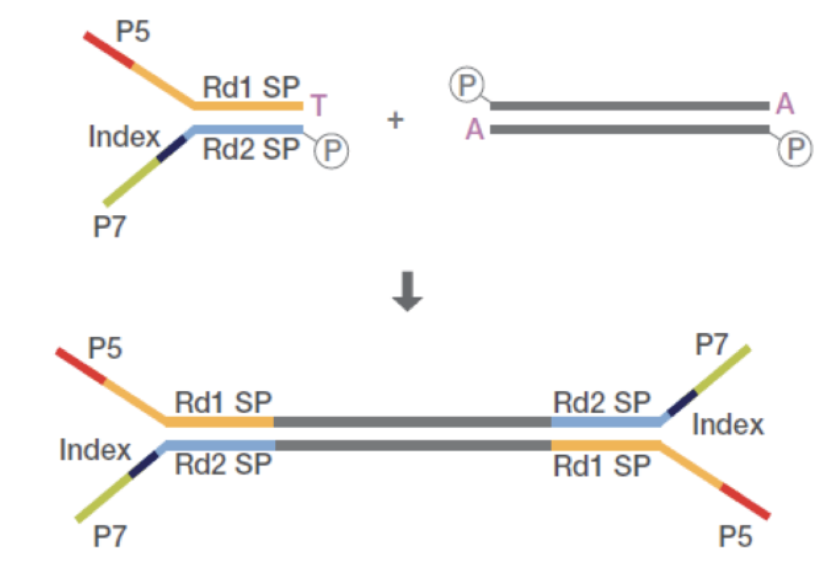
Unique Molecular Identifiers: UMI Barcoding
UMI in i7 (P7) arm of adapter is
added during ligation
Ligation product with i7 UMI

Slide 21
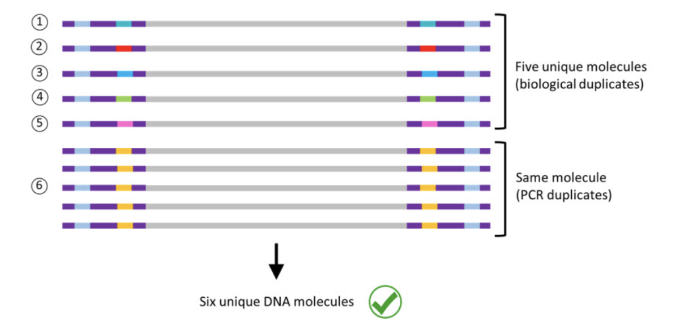
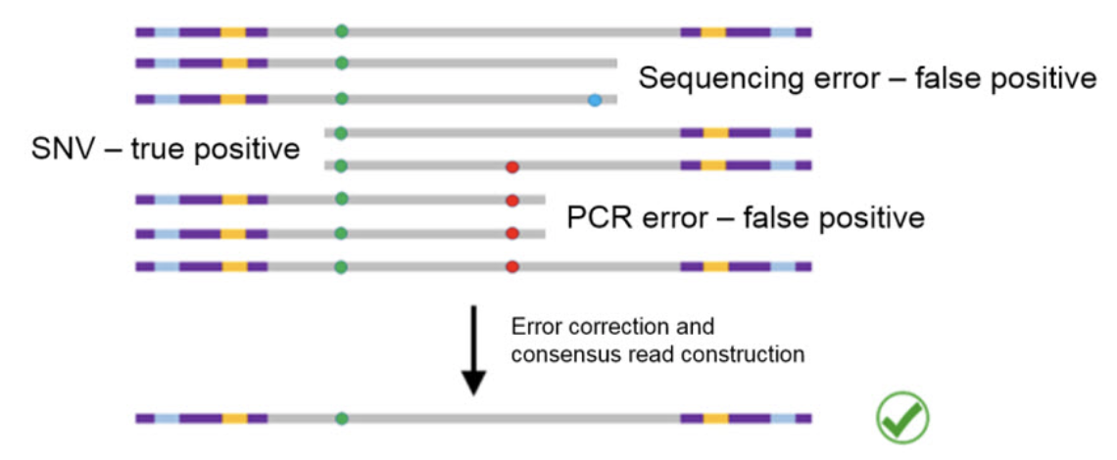
Dual Functionality of UMIs
De-duplication
Polymerase or base-calling error elimination

Slide 22
Illumina Sequencing Basics
Sequencing by Synthesis

Slide 23
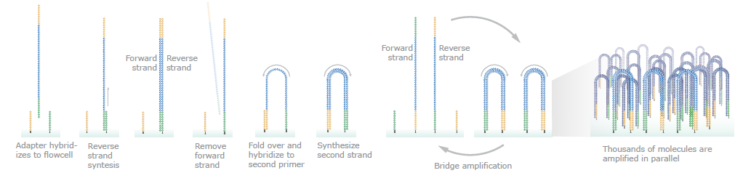
Cluster Amplification on FlowCell
Quantitating library fragments is an essential first step to cluster formation
Diluted library fragments are introduced to flow cell, and are amplified in situ using the covalently attached complementary adapter sequences
Cluster amplification is required to produce sufficient signal for detecting the sequencing reaction results at each nucleotide addition step = each cluster is derived from a single library fragment

Slide 24
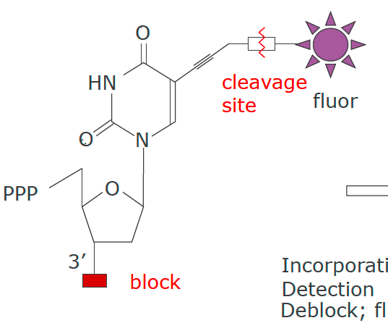
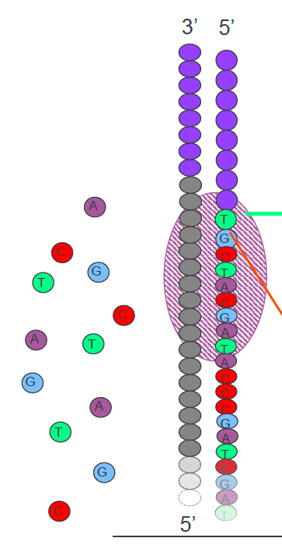
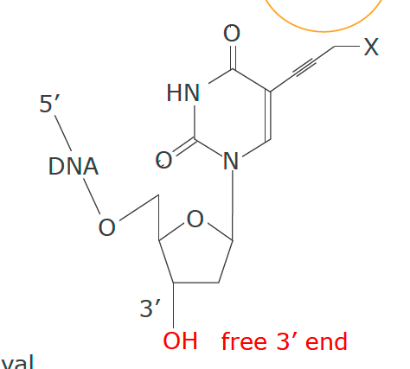
Sequencing Chemistry for SBS
Emission
Incorporate
Detect
De-block
Cleave fluor
Excitation

Slide 25
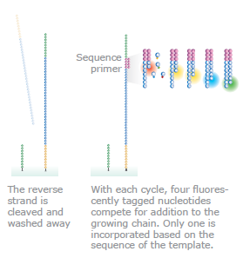
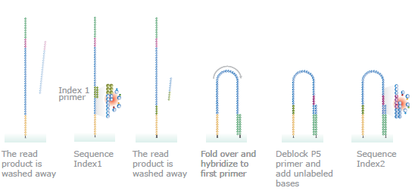
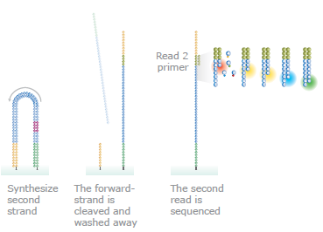
Sequencing by Synthesis

Slide 26
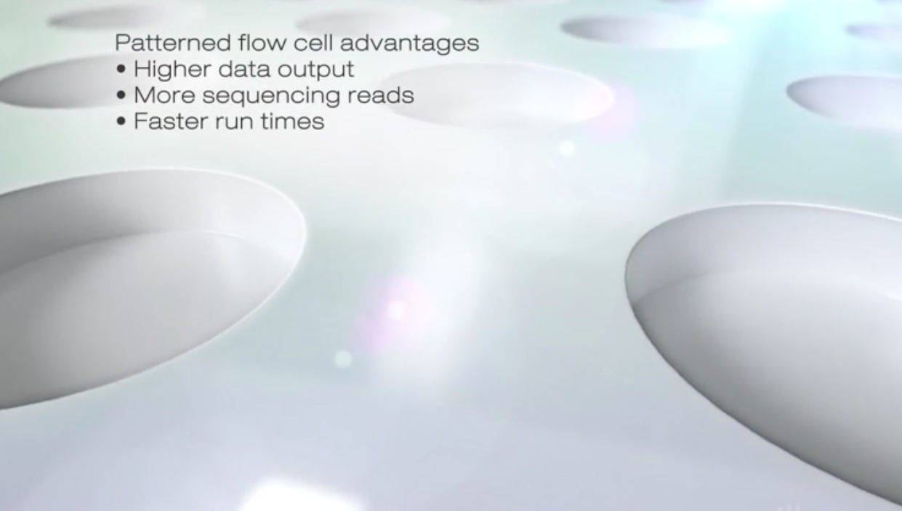
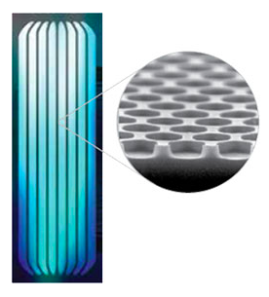
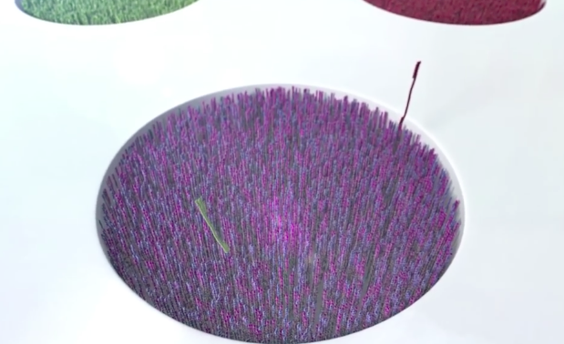
Patterned Flow Cell

Slide 27
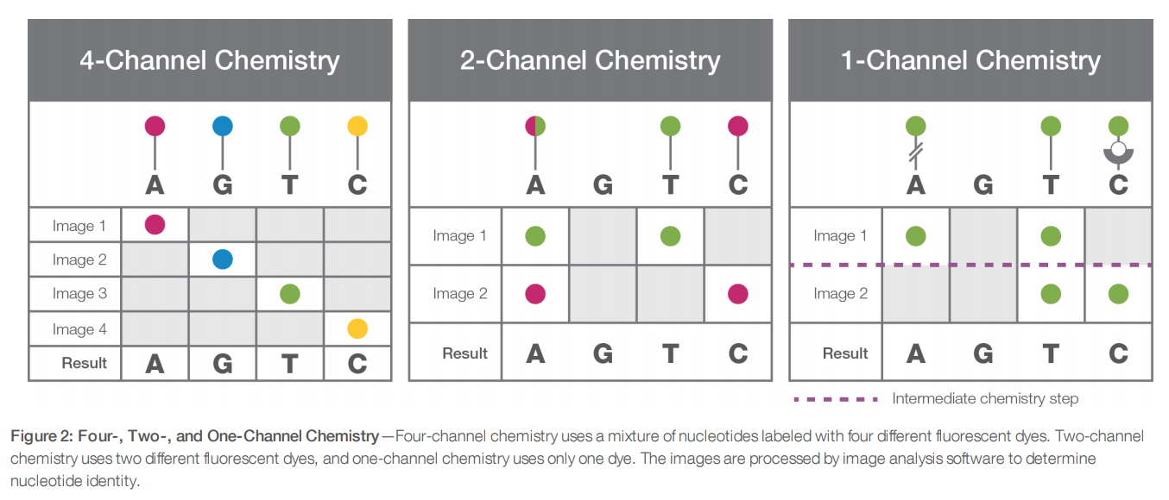
Four-, Two- and One-Color Chemistry
The MiSeq and HiSeq Series Systems currently use four-channel SBS.
The MiniSeq, NextSeq, and NovaSeq Systems use two-channel chemistry.
The iSeq 100 use one-channel chemistry.

Slide 28
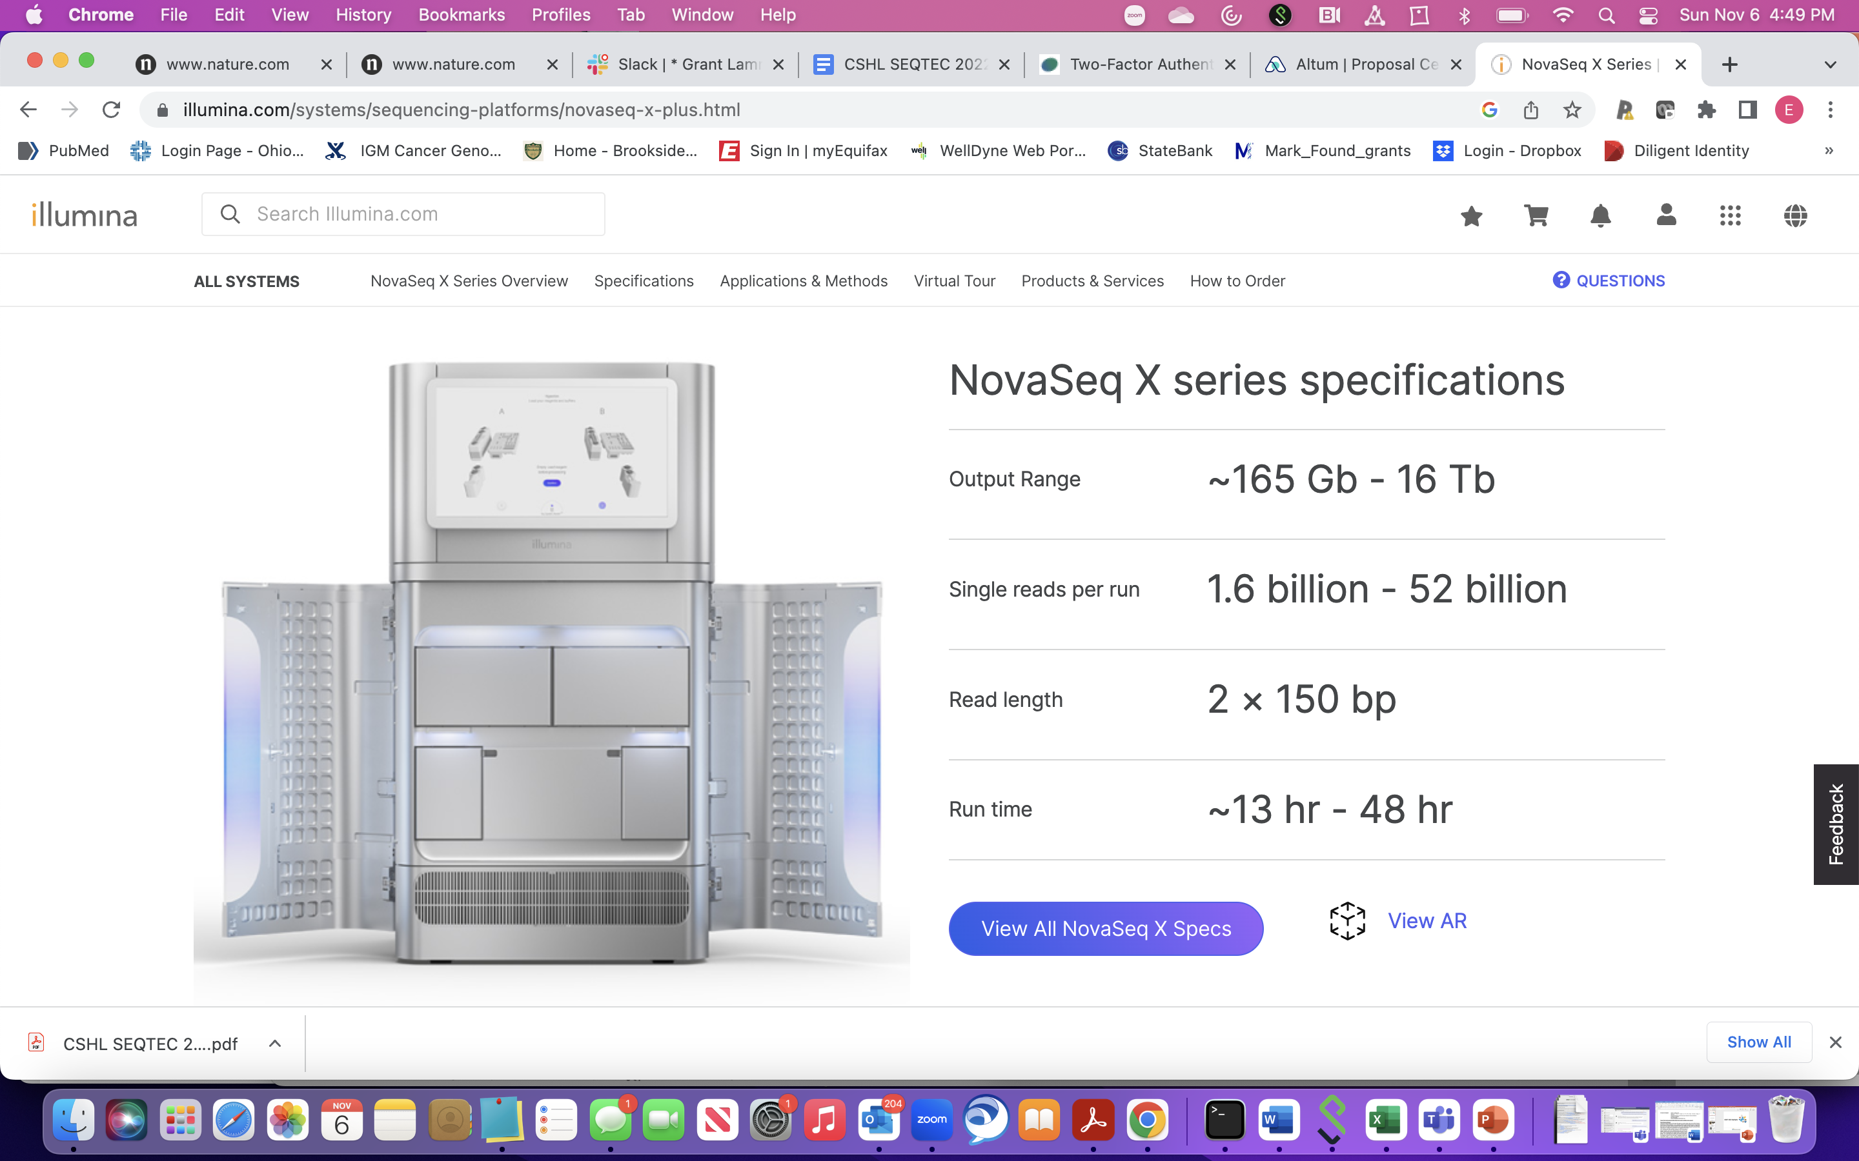
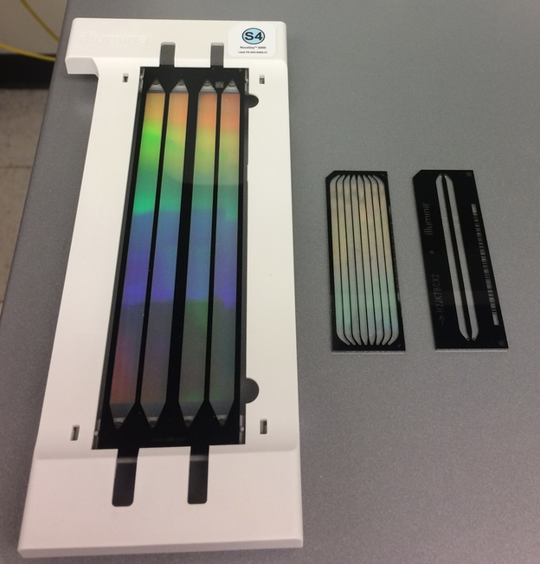
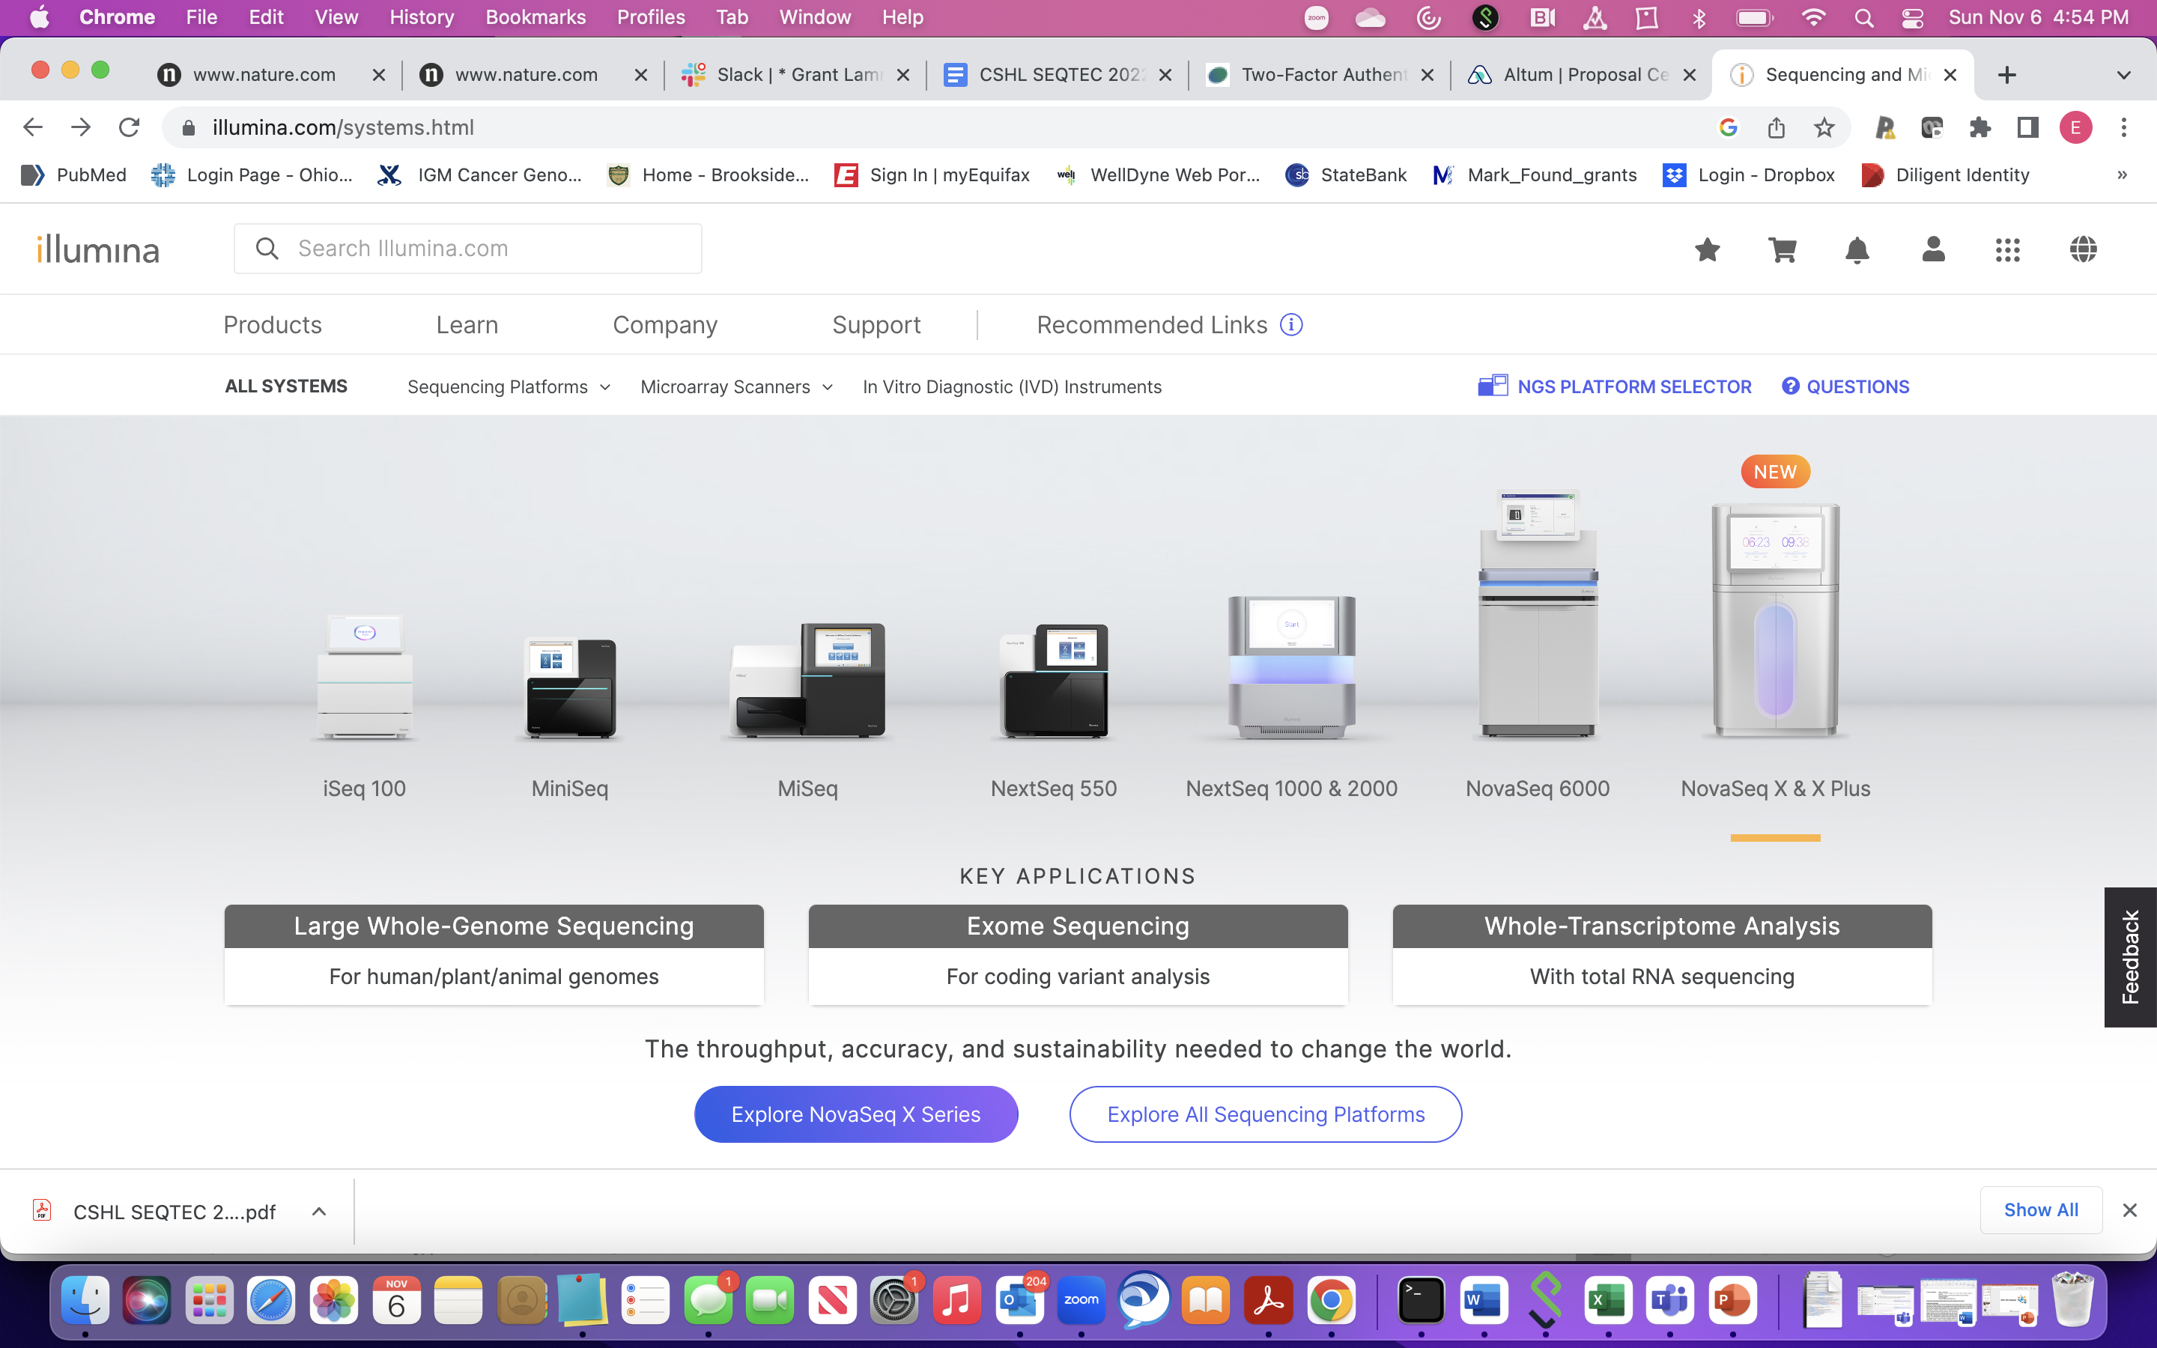
Illumina Platforms
High accuracy reads, paired end reads, range of capacity and throughput
Longer read lengths on some platforms (MiSeq)
Largest user base with accompanying software applications, Dragen rapid alignment/analysis

Slide 29
Ion Torrent Sequencing Technology
Sequencing by pH Sensing

Slide 30
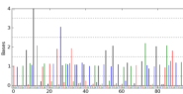
pH Sensing of Base Incorporation
On-bead fragment amplification by emulsion PCR
Unlabeled native dNTPs
Undefined read lengths

Slide 31
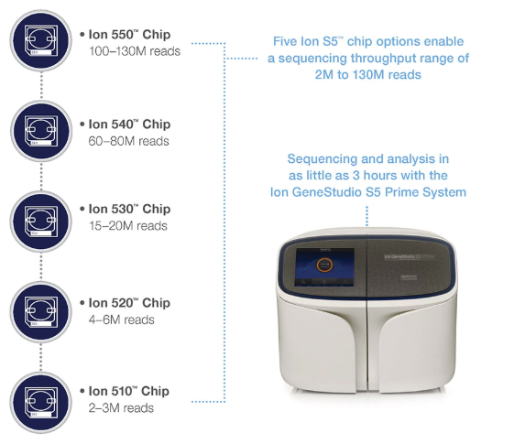
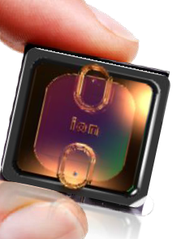
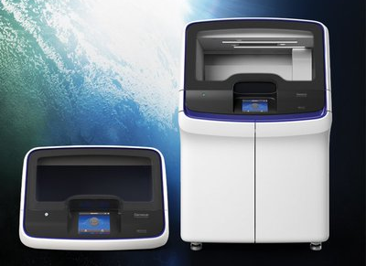
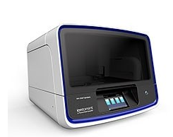
Thermo-Fisher Sequencing Platforms
Ion Torrent S5
Ion Chef
IonTorrent Genexus
Low substitution error rate, in/dels problematic, single end reads
Inexpensive and fast turn-around for data production
Clinical platform (Genexus)
Microbiome, immune gene sequencing applications

Slide 32
Sub-setting the Genome for NGS-based Assays
Exome and Gene Panels

Slide 33
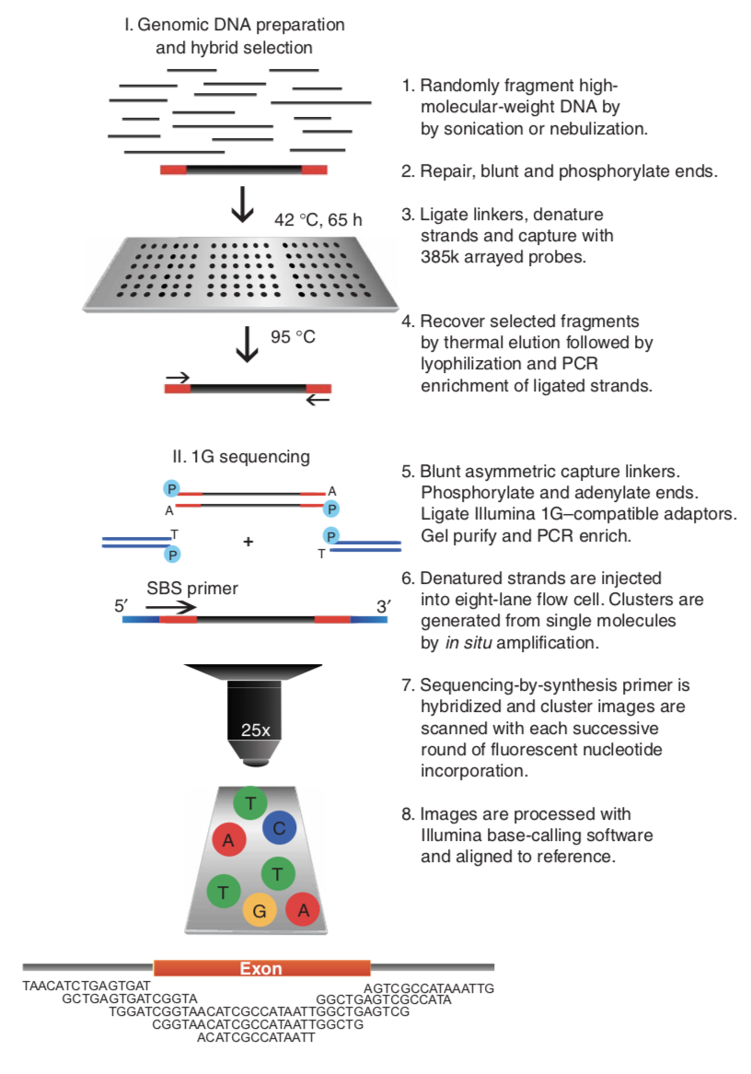
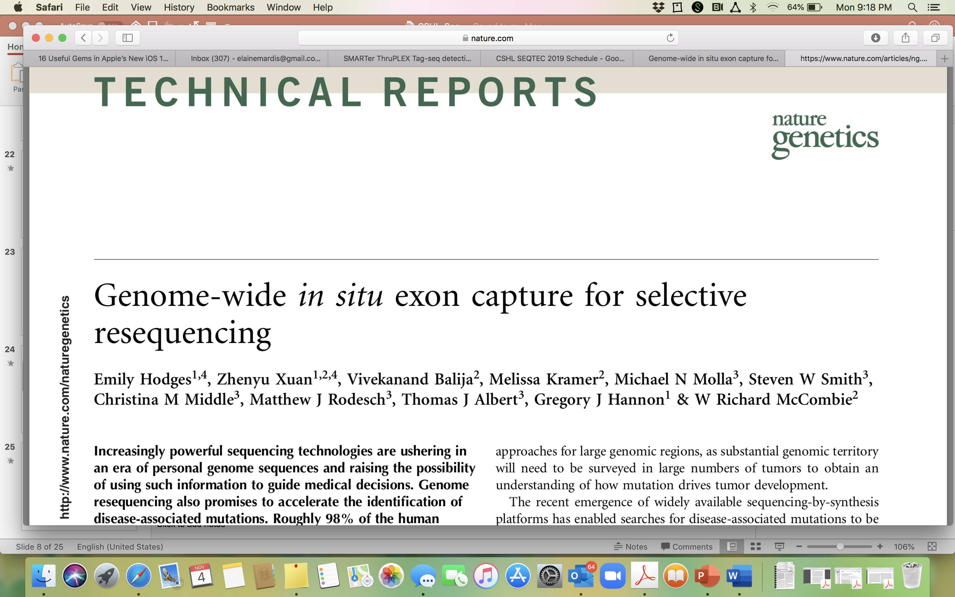
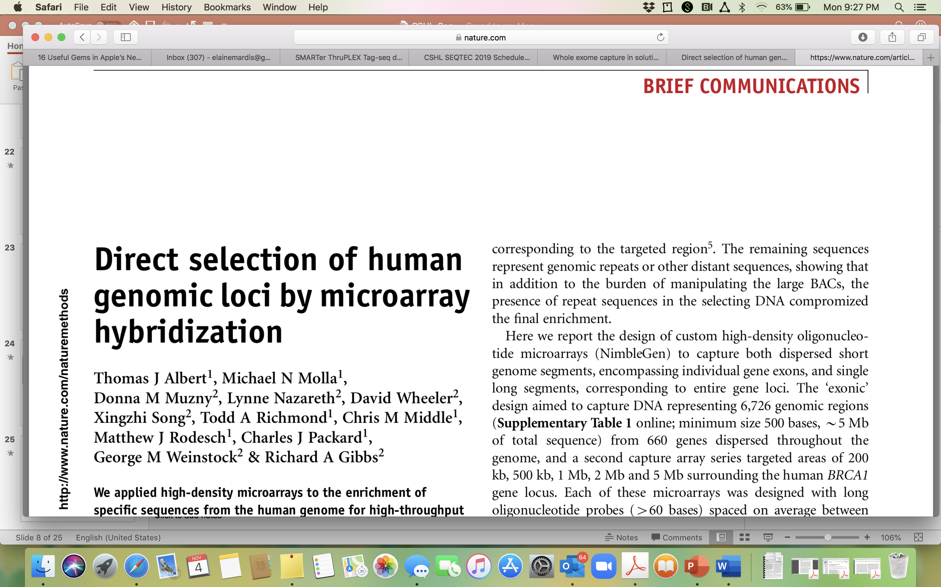
Direct Genomic Selection

Slide 34
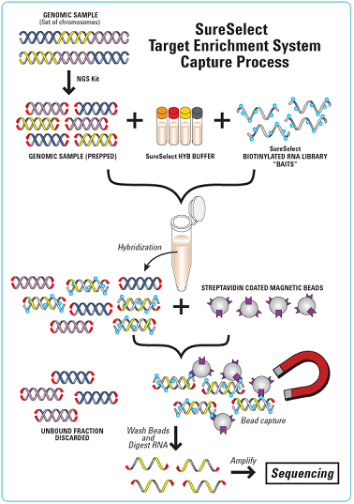
Solution-Phase Hybrid Capture
Hybrid capture - specific sequences from a whole genome library are selected by hybridization to probes that correspond to human exons or gene panels.
Probe DNAs are biotinylated, so hybrids can be removed from solution with streptavidin magnetic beads.
An “exome” by definition, is captured with probes corresponding to the exons of all genes annotated in the reference genome.
Custom capture reagents or “gene panels” can be synthesized to target specific loci that may be of clinical interest.

Slide 35
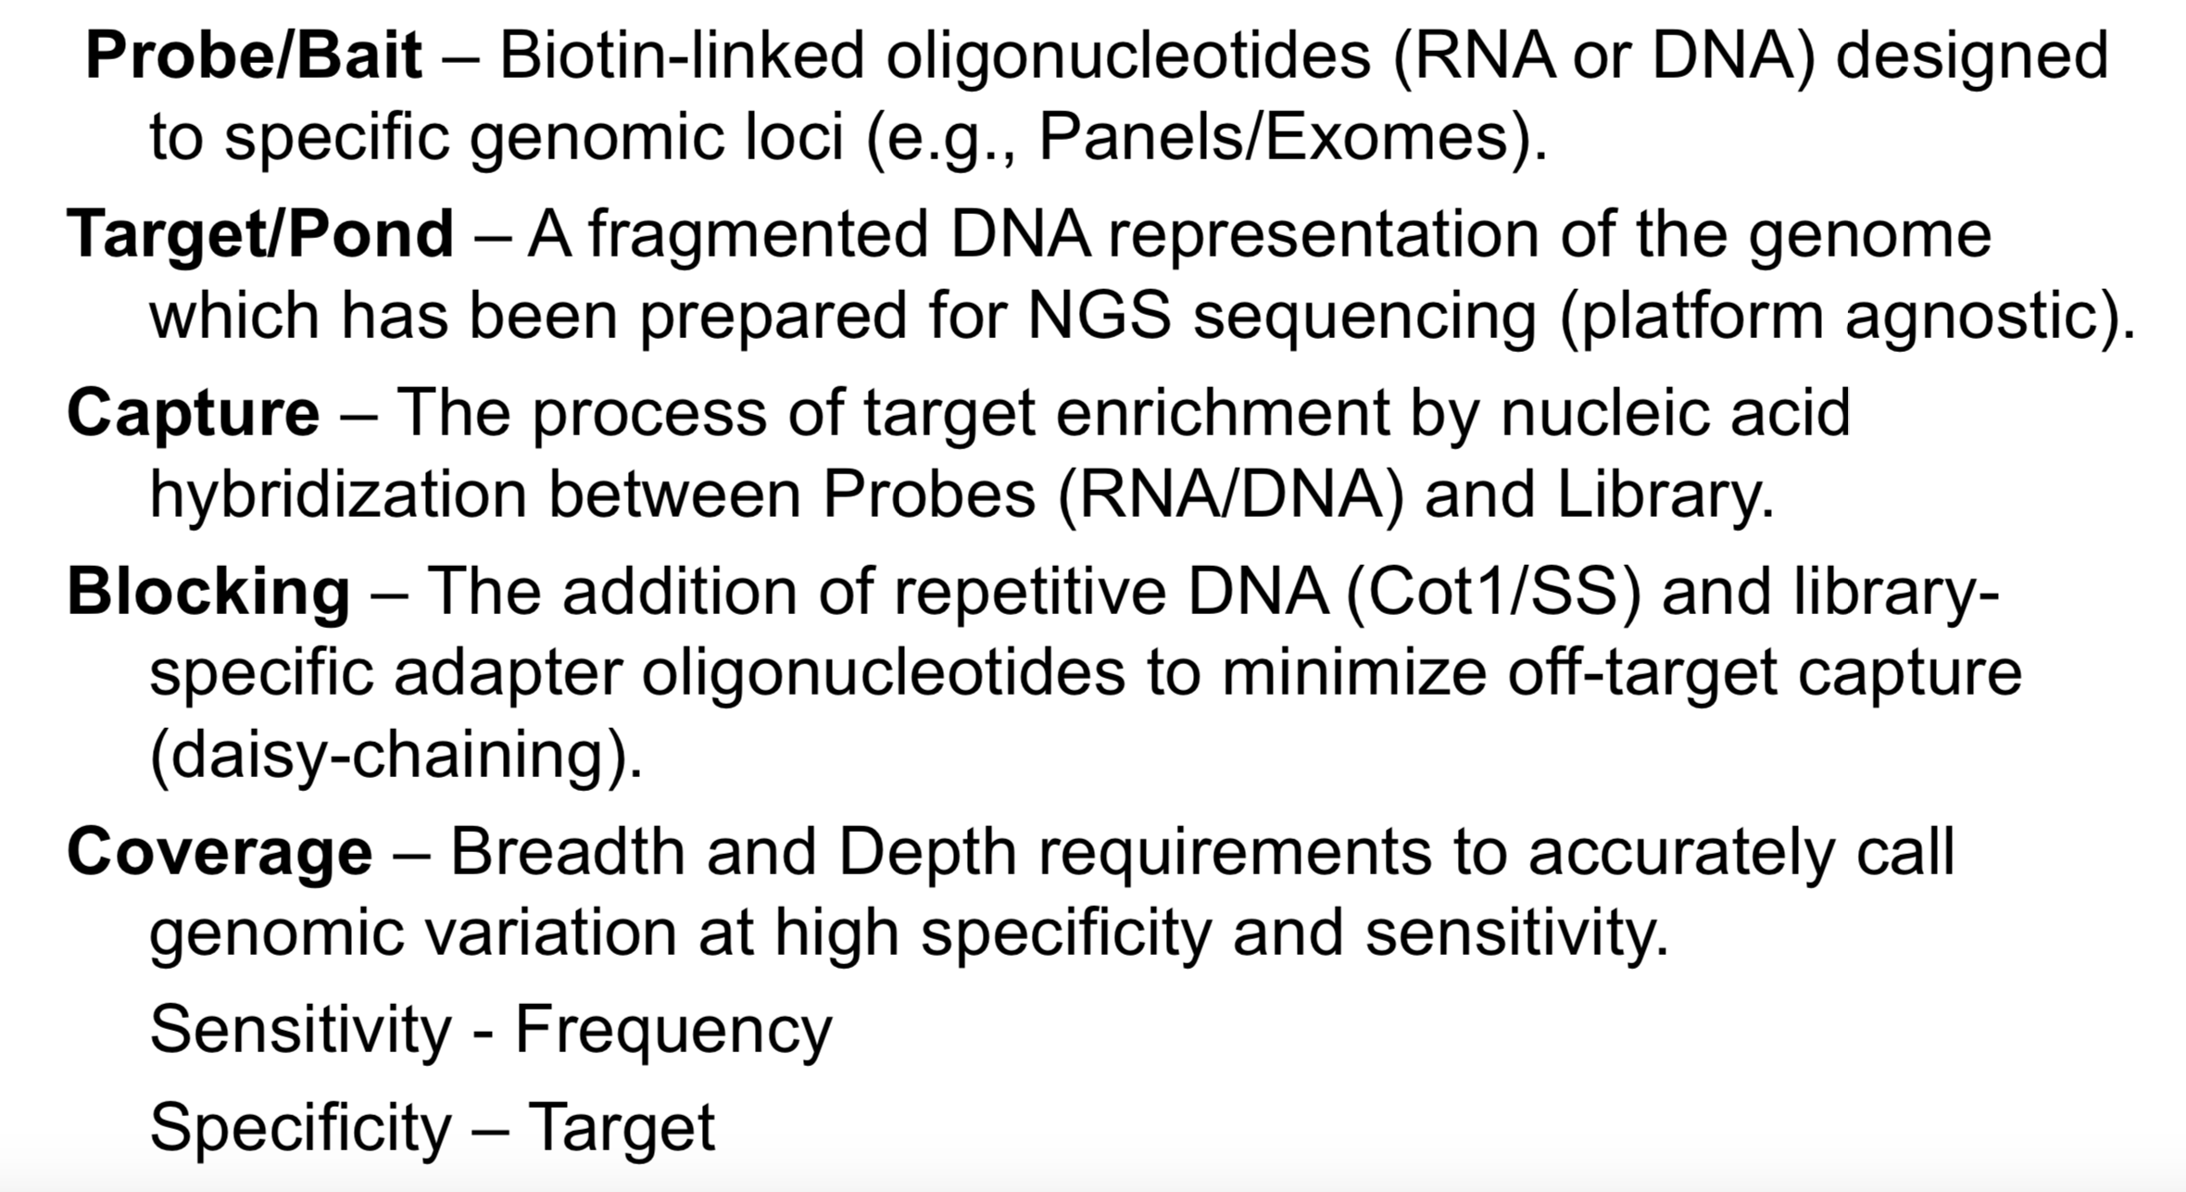
Hybrid Capture Terminology
Notes:
BED File!!

Slide 36
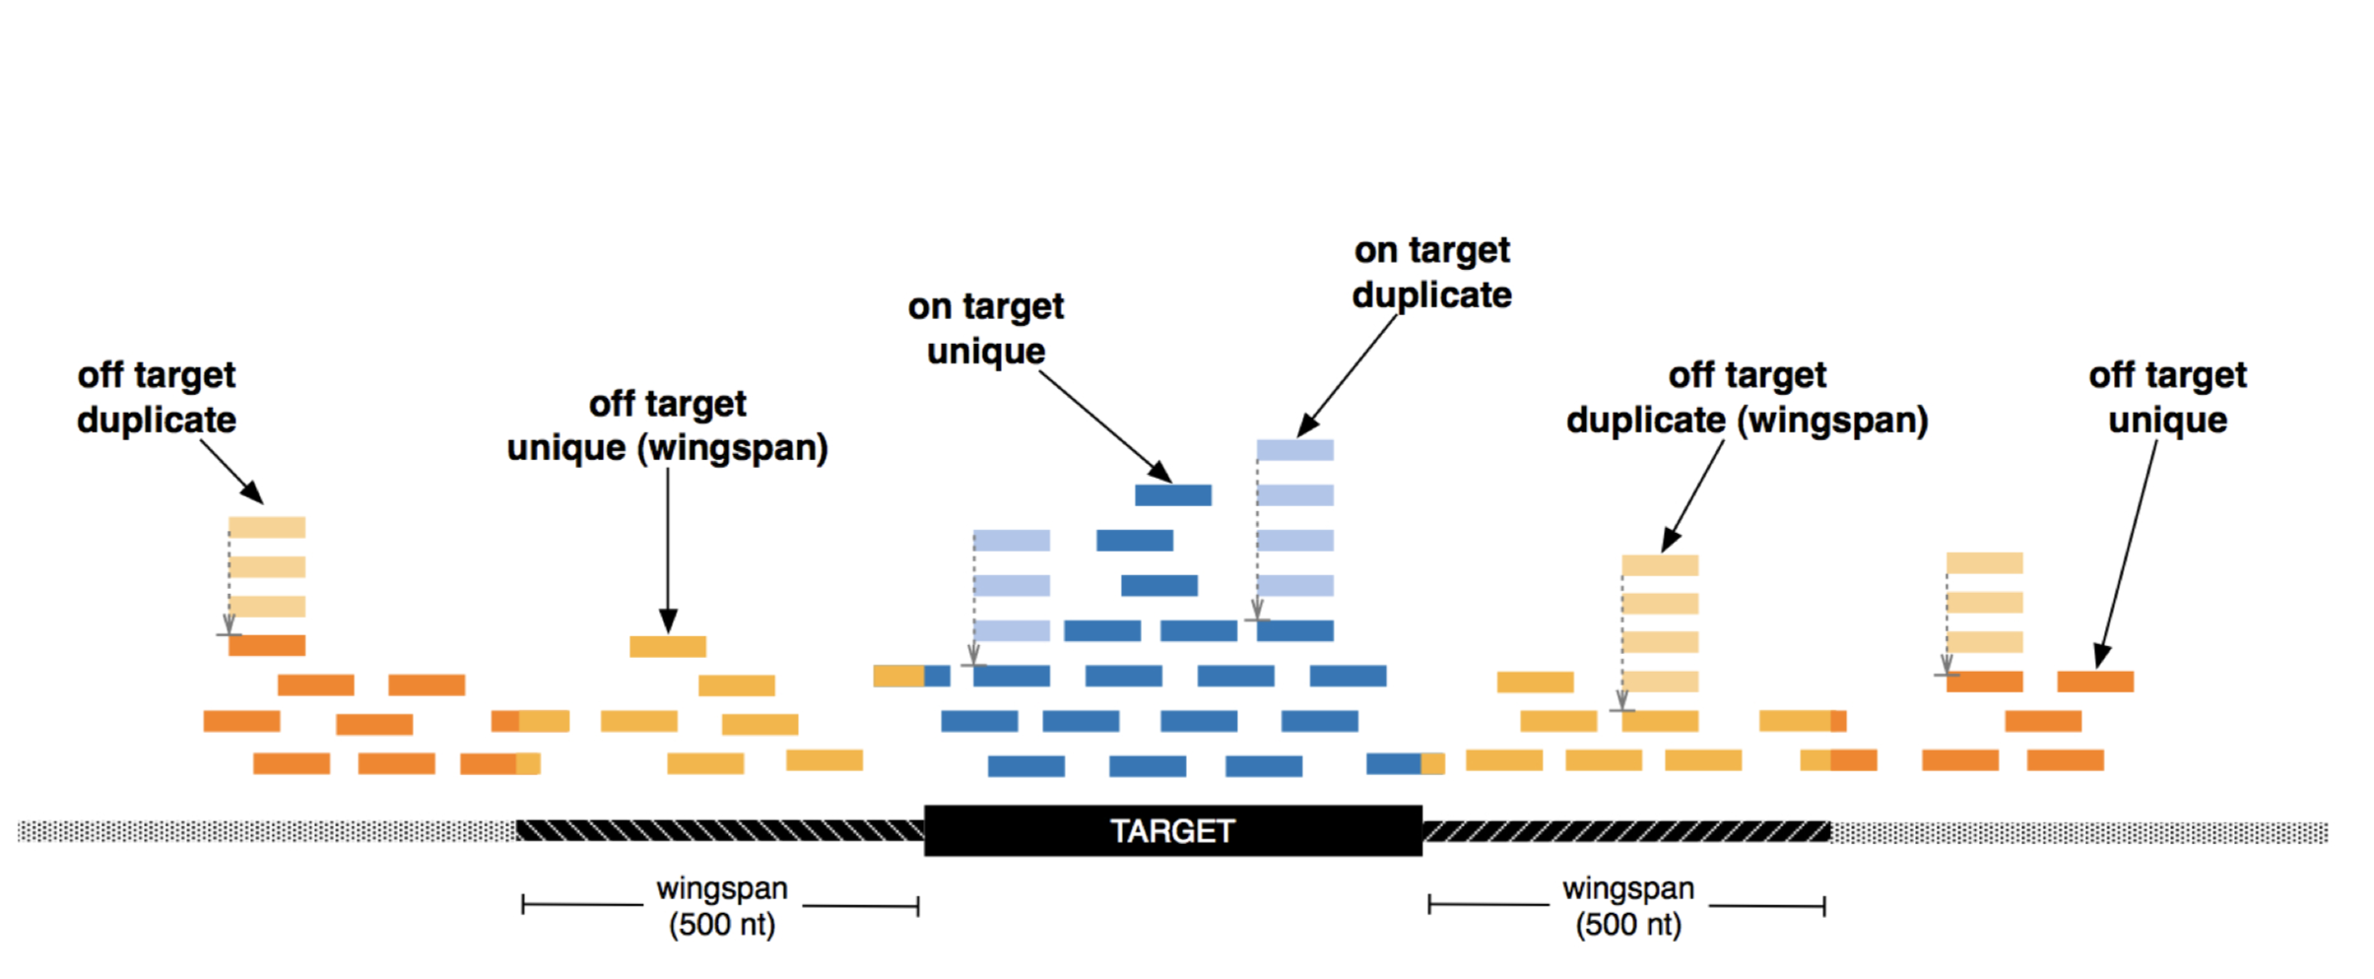
Coverage Definitions for Hybrid Capture

Slide 37
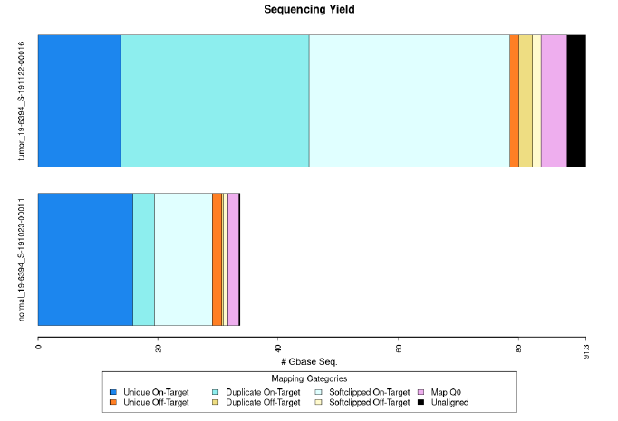
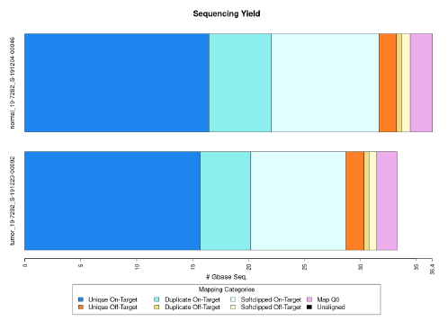
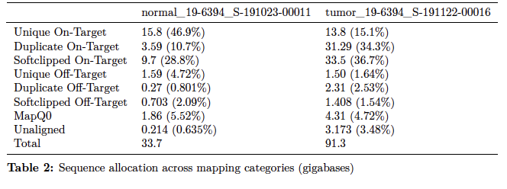
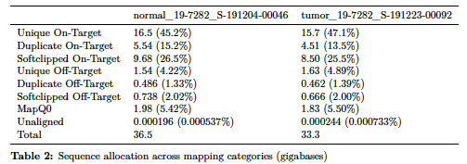
Evaluating Coverage Post-Alignment and De-dup

Slide 38
Evaluating Probe Coverage Breadth at Fixed Depth

Slide 39
Probe Coverage and Outlier Analysis

Slide 40
New Platforms for NGS
New competition for Illumina

Slide 41
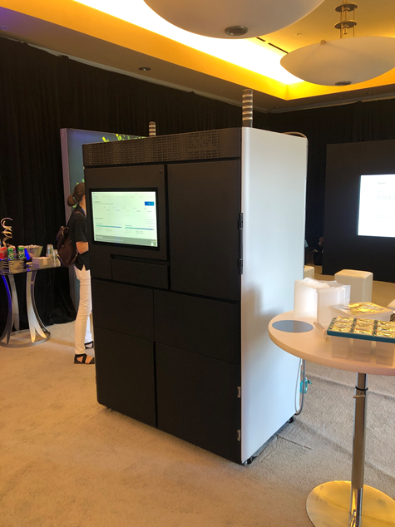
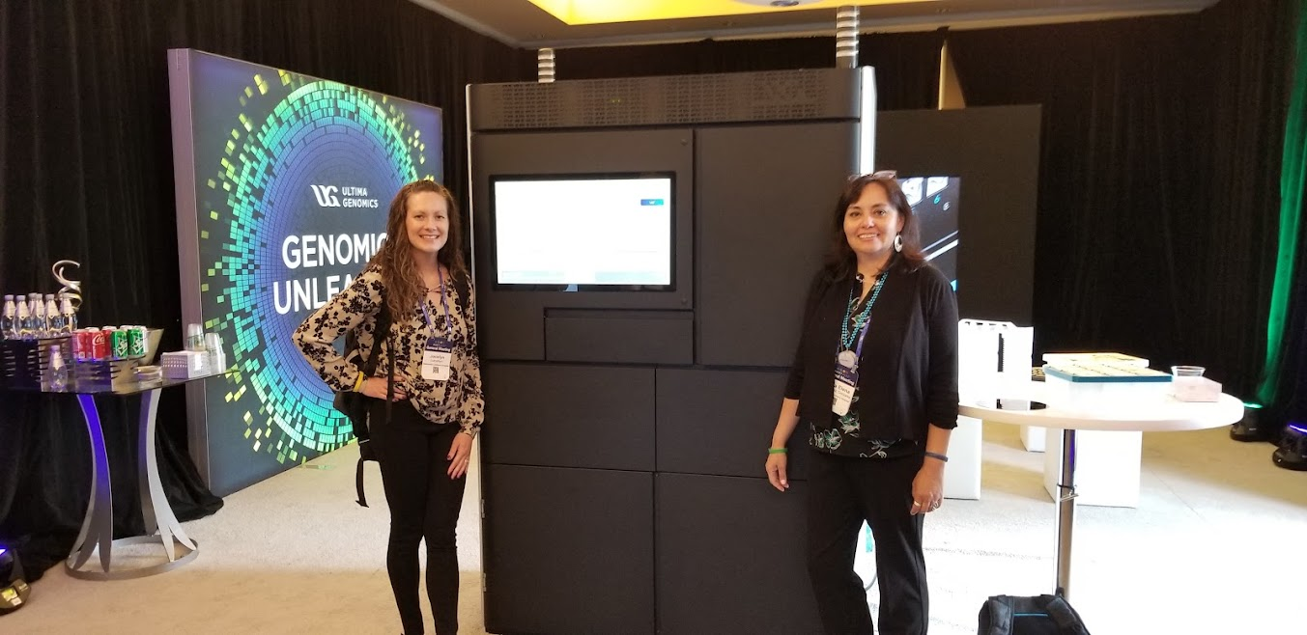
Ultima Genomics
The UG100
Footprint is the “Ultima”te of its kind
Three instruments total
Clustering
Sequencing
Computational

Slide 42
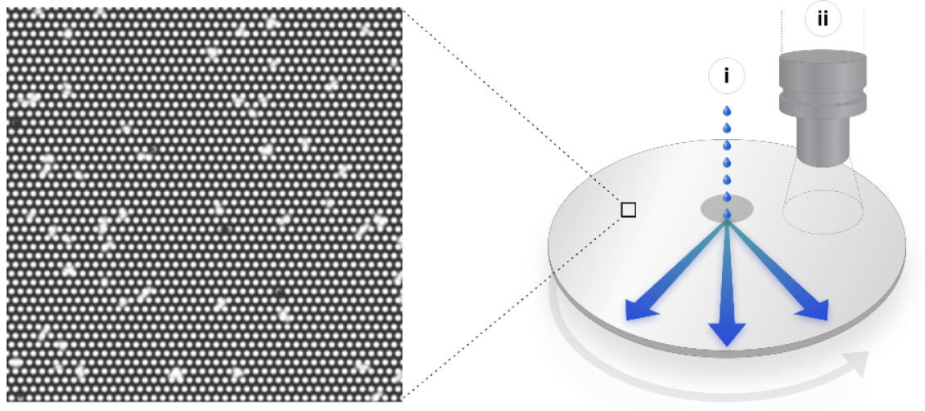
Ultima Genomics
Three main innovative components: (1) open fluidics and optics system
Circular silicon wafer as an “open flow-cell”
Patterned – dense array of electrostatic landing pads to bind sequencing beads
~10 billion clonally amplified beads
Spin-dispense system
Notes:
utilizing a circular 200mm silicon wafer as an “open flow-cell” with no consumable parts in the optical path. This wafer is patterned at micron scale generating a dense array of electrostatic landing pads to bind clonally amplified sequencing beads (emulsion PCR)
A spin dispense system delivers reagents to the wafer by dispensing reagents from dedicated nozzles near the center of the rotating wafer and distributing the reagents rapidly and uniformly across the wafer by centrifugal force
Wafers are cheap, large substrate surface, spin-dispense lowers dead-volume for reagents, design allows for rapid optical scanning

Slide 43
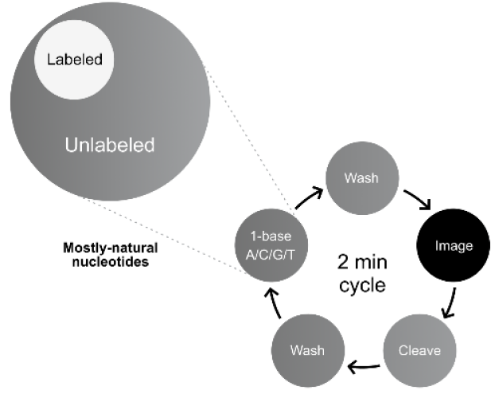
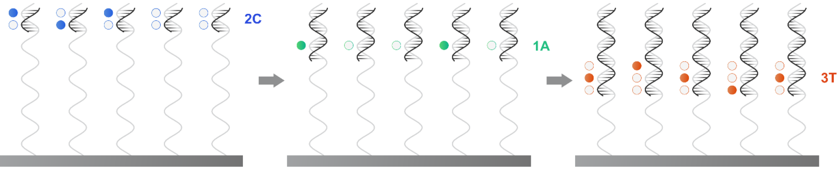
Ultima Genomics
Three main innovative components: (2) mostly natural sequencing chemistry
Sequencing-by-synthesis (mnSBS) uses a mixture of native dNTPs and one-at-a-time fluorescently labeled dNTP
Polymerase extends 0, 1 or several bases depending on respective homopolymer
Detected signal proportional to length of homopolymer
Notes:
Mostly natural sequencing-by-synthesis (mnSBS) comprises a minority (<20%) of fluorescently labeled, non-terminated nucleotides and a majority of unlabeled, non-terminated (natural) nucleotides (mostly natural nucleotide; MNN mix)
Resulting synthesized DNA is mostly unmodified by the incorporated base can still be detected based on the remaining hundreds of photons produced by each fluorescent label from that cluster.
For each sequencing cycle a single nucleotide base type of MNN mix is added to the clonal beads and polymerase extends 0,1 or several bases of that type depending on the length of the respective homopolymer in the corresponding template.
Following this chemistry step, entire active surface of substrate is scanned to measure the fluorescence level of each clonal bead. Fluorescence labels are cleaved, washed (~2min), amount of label nucleotide incorporated on a clonal bead is linearly proportional to the length of the respective homopolymer in the template, signal is proportional to the length of the homopolymer.
Use of mostly natural SBS eliminates most scarring effects of reversible-terminating chemistries, allowing for faster run times and longer read lengths.

Slide 44



Ultima Genomics
Three main innovative components: (3) neural network-enabled base-calling
Machine learning and convolutional neural network (CNN) to convert raw signals to sequence reads; run-specific calibration process; CRAM file
HG001-HG007 Generated Data
444 cycles and a 20 hr run time
Mode 310 bp
94.5% of bases BQ≥20
Notes:
Compressed Reference-oriented Alignment Map (CRAM): CRAM is a more highly compressed alternative to the BAM and SAM DNA sequence alignment file formats. CRAM is a format designed by the European Bioinformatics Institute. It uses reference-based compression, meaning that only base calls that differ to a designated reference sequence need to be stored.
444 flow cycles
20 hr run time
Avg. 282 bp; mode 310 bp
60x mean coverage (40x used for analysis)

Slide 45


Ultima Genomics
Three main innovative components: (3) neural network-enabled base-calling
90% accuracy for homopolymer at 8 bp
GIAB Mean
SNP: 99.7% recall; 99.6% precision
Indel: 96.1% recall; 96.7% precision
Notes:
Compressed Reference-oriented Alignment Map (CRAM): CRAM is a more highly compressed alternative to the BAM and SAM DNA sequence alignment file formats. CRAM is a format designed by the European Bioinformatics Institute. It uses reference-based compression, meaning that only base calls that differ to a designated reference sequence need to be stored.
444 flow cycles
20 hr run time
Avg. 282 bp; mode 310 bp
60x mean coverage (40x used for analysis)

Slide 46
Ultima Genomics Summary
Technology: mostly natural sequencing-by-synthesis (mnSBS)
Output: 10 billion clonally amplified beads; 2 Wafers at a time
Runtime: 20 hr
Length of reads: 310 bp mode size (GIAB)
Accuracy:
SNP: 99.7% recall; 99.6% precision
Indel: 96.1% recall; 96.7% precision
Instrument cost: Unknown (comparable to Illumina NovaSeq 6000)
Instrument size (relative): Several NovaSeqs worth
Partnerships/acquisitions:
AI partnerships with Google DeepVariant, NVIDIA and Senteon
Exact Sciences, Regeneron Pharmaceuticals, NYGC and Broad Institute: beta testing—both NYGC and Broad have purchased

Slide 47


Element Biosciences – AVITI Benchtop Sequencer
Highlights
Two independent, random-access flow cells (>1b paired-end reads output per flow cell)
FASTQ file output (conversion performed by AVITI Operating Software Bases2Fastq workflow)
Three library workflows (Adept – conversion of existing libraries ; Elevate – Aviti library preparation, LoopSeq—long read sequencing approach)
Tunable optical throughput (full scan, ½ scan, ¼ scan etc..) to select desired TAT/read depth
Notes:
Independent – different types of read lengths, different cartridges, different run recipes, different throughputs

Slide 48



Element Biosciences - AVITI
Circularization
Off-instrument library circularized prior to sequencing
"Working to move onto the flow cell"
Pollination
Rolling circular amplification on flow cell surface creates clonal copies of the library molecule or "polony"
Sequencing
Instead of binding an individual labeled nucleotide at each location of the cluster, AVITI uses single fluor with many octopus-like tentacle arms (Avidite)
Avidite nucleotide substrate
Each arm, single nt type
One avidite = multiple binding sites within the polony = increased binding avidity
Element Biosciences - Resources
Notes:
The linear library is denatured and annealed to a splint oligo. A ligation reaction circularizes the library that is then cleaned up using enzymatic digestion and purification beads.
A circularization reaction supports one linear library or a pool of up to 96 indexed linear libraries as input.
Pollination
Instead of binding a single labeled nucleotide at each of those thousands of locations in the cluster, AVITI technology uses a different approach: a single fluor with many octopus-like tentacle arms, each arm having a single nucleotide type.
The AVITI octopus-like labeled molecule is called an Avidite and has four different colors, and four different nucleotides. 100s of avidites bind per DNA feature, generates scalable signal. On the core of the avidite—the body of the octopus—are multiple fluorophores that are measured by an optical imaging system. The avidity comes when one avidite, with multiple nucleotides, binds on multiple contact points to create a tighter binding.
They claim translates to a stronger/scalable signal, less background, lower concentrations of needed reagents, ultimately lower cost

Slide 49

Aviti Cloudbreak Chemistry
20% faster run times
Reads index 1 and 2 first for initial run/library quality control purposes
Improved data quality at the ends of reads, and at homopolymers

Slide 50

Element Biosciences – AVITI Key Performance Metrics
Notes:
Partial read of the flow cell

Slide 51

Pacific Biosciences: Onso
Sequencing By Binding (SBB) Technology: interrogation followed by incorporation
Accuracy: 90% of bases >Q40
Improved homopolymer accuracy
Output: Up to 500M paired-end reads
Demultiplexed FASTQ
Runtime: <24 hours
Length of reads: 2x150, or 1x200
50-65Gb output
Accuracy:
Google DeepVariant calling
99.25% Indels
99.7% SNVs
Each cycle initiates with a 3’ reversible blocked nucleotide.
Fluorescently labelled nucleotides are then flowed over
the flow cell allowing for the appropriate base to bind.
Unbound nucleotides are washed away so that the base
can be interrogated with reduced background signal.
(3) The 3’ end of the nucleotide is activated via removal of the
reversible terminator.
(4) Native, unlabeled, reversible blocked nucleotides incorporate
the cognate base into the growing strand.
Notes:
SBB:
>90% bases at Q40+
Low duplications rate
No index hopping
Sequence through difficult /repetitive regions

Slide 52
Conclusions
Widespread use of NGS platforms for biological research has changed the scale of biomedical inquiry and discovery
A variety of platforms and approaches are available for implementation of NGS, each with strengths and weaknesses.
Core experimental design considerations play an important role in optimizing the data output from NGS platforms and maintaining data quality and reproducibility
Due to the size and complexity of the resulting data sets, validated approaches to assure quality of the data, along with analytical pipelines having appropriate sensitivity, specificity and reproducibility are required.
Similarly, data visualization interfaces are needed to permit genome-wide and locus-specific evaluation of variants and underlying data support.

